Slide 1
Dot net Performance Improvement

Slide 2
Goals
Understanding Memory Management
Memory Leaks
Using Performance Counters
Performance Measure and Leak Detection Tools

Slide 3
Understanding Memory Management

Slide 4
Understanding Memory Management
Garbage Collection
Automatic memory management is made possible by Garbage Collection in .NET Framework.
When a class object is created at runtime, certain memory space is allocated to it in the heap memory.
However, after all the actions related to the object are completed in the program, the memory space allocated to it is a waste as it cannot be used.
In this case, garbage collection is very useful as it automatically releases the memory space after it is no longer required.

Slide 5
Understanding Memory Management
Garbage collection will always work on Managed Heap and internally it has an Engine which is known as the Optimization Engine.
Garbage Collection occurs if at least one of multiple conditions is satisfied.
These conditions are given as follows:
If the system has low physical memory, then garbage collection is necessary.
If the memory allocated to various objects in the heap memory exceeds a pre-set threshold, then garbage collection occurs.
If the GC.Collect method is called, then garbage collection occurs. However, this method is only called under unusual situations as normally garbage collector runs automatically.

Slide 6
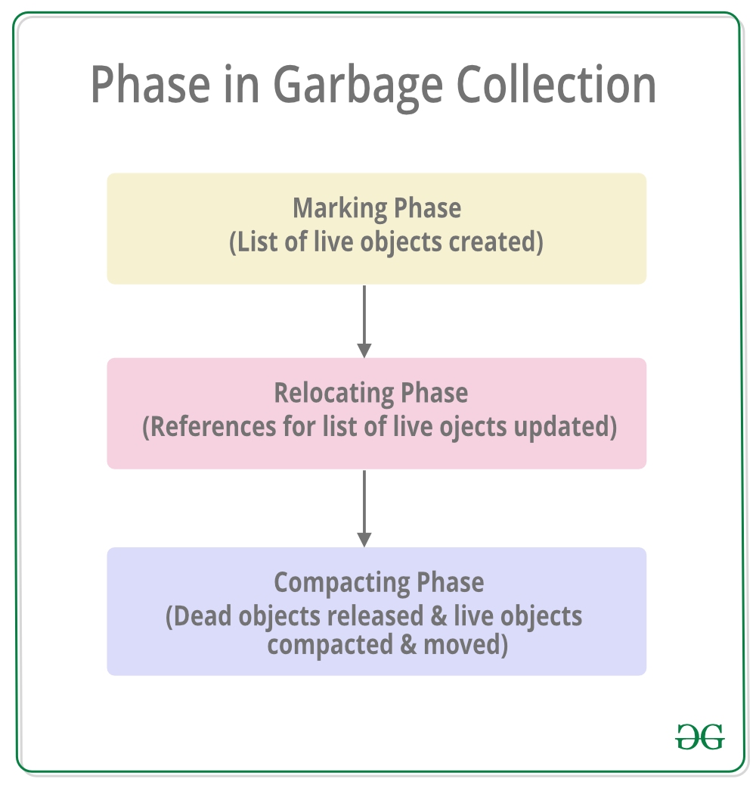
Understanding Memory Management

Slide 7
Understanding Memory Management
Marking Phase: A list of all the live objects is created during the marking phase. This is done by following the references from all the root objects. All of the objects that are not on the list of live objects are potentially deleted from the heap memory.
Relocating Phase: The references of all the objects that were on the list of all the live objects are updated in the relocating phase so that they point to the new location where the objects will be relocated to in the compacting phase.
Compacting Phase: The heap gets compacted in the compacting phase as the space occupied by the dead objects is released and the live objects remaining are moved. All the live objects that remain after the garbage collection are moved towards the older end of the heap memory in their original order.

Slide 8
Heap Generations in Garbage Collection
The heap memory is organized into 3 generations so that various objects with different lifetimes can be handled appropriately during garbage collection.
The memory to each Generation will be given by the Common Language Runtime(CLR) depending on the project size.
Internally, Optimization Engine will call the Collection Means Method to select which objects will go into Gneration 1 or Generation 2.

Slide 9
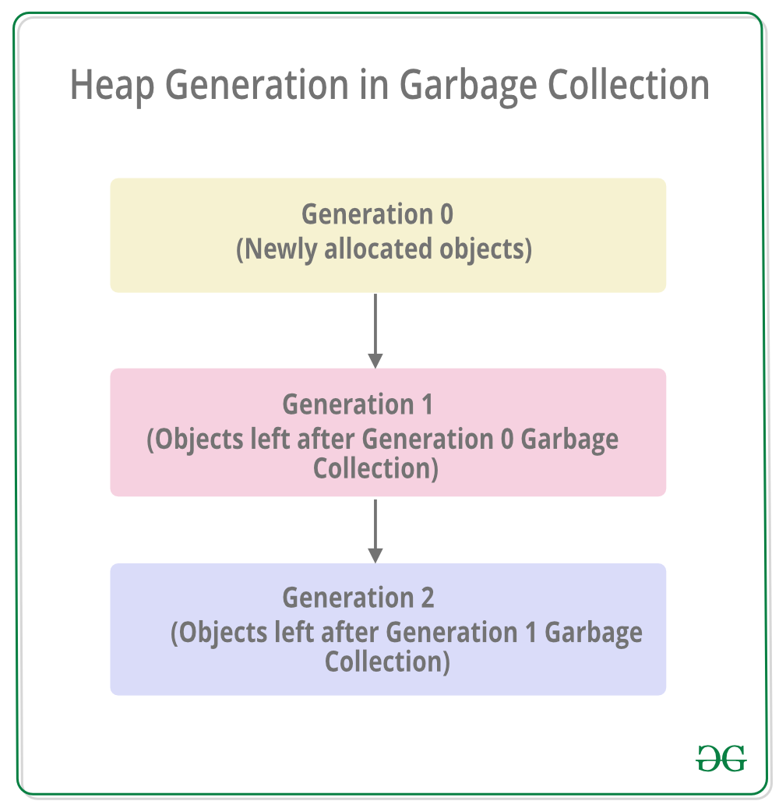
Heap Generations in Garbage Collection

Slide 10
Heap Generations in Garbage Collection
Generation 0 : All the short-lived objects such as temporary variables are contained in the generation 0 of the heap memory. All the newly allocated objects are also generation 0 objects implicitly unless they are large objects. In general, the frequency of garbage collection is the highest in generation 0.
Generation 1 : If space occupied by some generation 0 objects that are not released in a garbage collection run, then these objects get moved to generation 1. The objects in this generation are a sort of buffer between the short-lived objects in generation 0 and the long-lived objects in generation 2.
Generation 2 : If space occupied by some generation 1 objects that are not released in the next garbage collection run, then these objects get moved to generation 2. The objects in generation 2 are long lived such as static objects as they remain in the heap memory for the whole process duration.

Slide 11
Heap Generations in Garbage Collection
Garbage collection of a generation implies the garbage collection of all its younger generations.
This means that all the objects in that particular generation and its younger generations are released.
Because of this reason, the garbage collection of generation 2 is called a full garbage collection as all the objects in the heap memory are.released.
Also, the memory allocated to the Generation 2 will be greater than Generation 1’s memory and similarly the memory of Generation 1 will be greater than Generation 0’s memory(Generation 2 > Generation 1 > Generation 0).

Slide 12
Benefits of Garbage Collection
Garbage Collection succeeds in allocating objects efficiently on the heap memory using the generations of garbage collection.
Manual freeing of memory is not needed as garbage collection automatically releases the memory space after it is no longer required.
Garbage collection handles memory allocation safely so that no objects use the contents of another object mistakenly.
The constructors of newly created objects do not have to initialize all the data fields as garbage collection clears the memory of objects that were previously released.

Slide 13
Large Object Heap
The CLR manages two different heaps for allocation, the small object heap (SOH) and the large object heap (LOH).
Any allocation greater than or equal to 85,000 bytes goes on the LOH.
Copying large objects has a performance penalty, so the LOH is not compacted unlike the SOH.
Another defining characteristic is that the LOH is only collected during a generation 2 collection.
Together, these have the built-in assumption that large object allocations are infrequent.

Slide 14
Large Object Heap
Because the LOH is not compacted, memory management is more like a traditional allocator.
The CLR keeps a free list of available blocks of memory.
When allocating a large object, the runtime first looks at the free list to see if it will satisfy the allocation request.
When the GC discovers adjacent objects that died, it combines the space they used into one free block which can be used for allocation.
Because a lot of interaction with the free list takes place at the time of allocation, there are tradeoffs between speed and optimal placement of memory blocks.

Slide 15
Large Object Heap
A condition known as fragmentation can occur when nothing on the free list can be used.
This can result in an out-of-memory exception despite the fact that collectively there is enough free memory.
For developers who work with a lot of large objects, this error condition may be familiar.
Microsoft received a lot of feedback requesting for a solution to LOH fragmentation.

Slide 16
A Better LOH Allocator
In .NET 4.5, two improvements happened to the large object heap.
First, significantly improved the way the runtime manages the free list, thereby making more effective use of fragments.
Now the memory allocator will revisit the memory fragments that earlier allocation couldn’t use.
Second, when in server GC mode, the runtime balances LOH allocations between each heap.
Prior to .NET 4.5, we only balanced the SOH.
It is observed substantial improvements in some of LOH allocation benchmarks as a result of both changes.

Slide 17
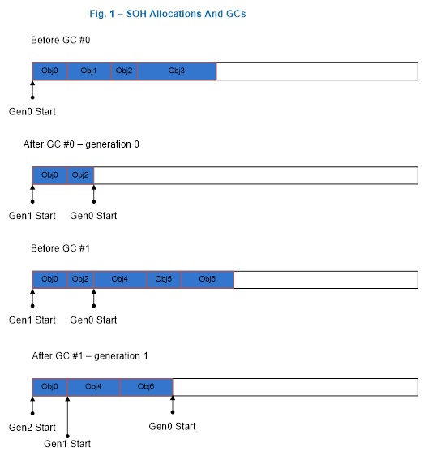
A generation 0 and a generation 1 GC.

Slide 18
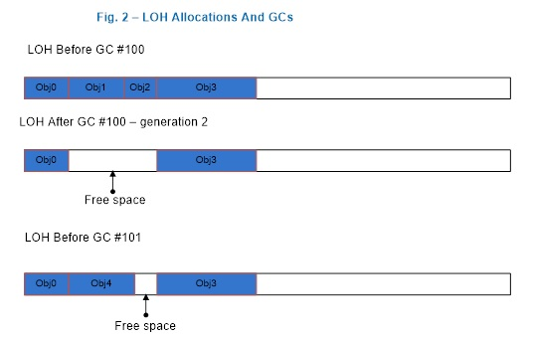
After a generation 2 GC

Slide 19
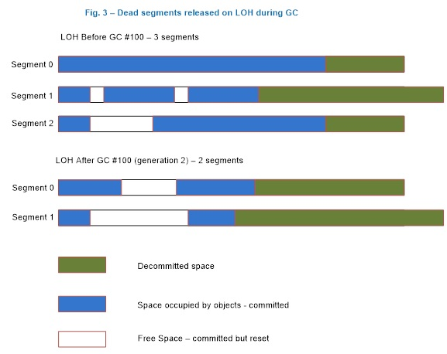
The LOH after a generation 2 GC

Slide 20
When is a large object collected?
Allocation exceeds the generation 0 or large object threshold.
The threshold is a property of a generation. A threshold for a generation is set when the garbage collector allocates objects into it.
When the threshold is exceeded, a GC is triggered on that generation. When you allocate small or large objects, you consume generation 0 and the LOH’s thresholds, respectively.
When the garbage collector allocates into generation 1 and 2, it consumes their thresholds. These thresholds are dynamically tuned as the program runs.
This is the typical case; most GCs happen because of allocations on the managed heap.

Slide 21
When is a large object collected?
The GC.Collect method is called.
If the parameterless GC.Collect() method is called or another overload is passed GC.MaxGeneration as an argument, the LOH is collected along with the rest of the managed heap.
The system is in low memory situation.
This occurs when the garbage collector receives a high memory notification from the OS. If the garbage collector thinks that doing a generation 2 GC will be productive, it triggers one.

Slide 22
LOH Performance Implications
Allocation cost.
The CLR makes the guarantee that the memory for every new object it gives out is cleared.
This means the allocation cost of a large object is completely dominated by memory clearing (unless it triggers a GC).
If it takes 2 cycles to clear one byte, it takes 170,000 cycles to clear the smallest large object.
Clearing the memory of a 16MB object on a 2GHz machine takes approximately 16ms. That's a rather large cost.

Slide 23
LOH Performance Implications
Collection cost.
Because the LOH and generation 2 are collected together, if either one's threshold is exceeded, a generation 2 collection is triggered.
If a generation 2 collection is triggered because of the LOH, generation 2 won't necessarily be much smaller after the GC.
If there's not much data on generation 2, this has minimal impact.
But if generation 2 is large, it can cause performance problems if many generation 2 GCs are triggered.
If many large objects are allocated on a very temporary basis and you have a large SOH, you could be spending too much time doing GCs.
In addition, the allocation cost can really add up if you keep allocating and letting go of really large objects.

Slide 24
LOH Performance Implications
Array elements with reference types.
Very large objects on the LOH are usually arrays (it's very rare to have an instance object that's really large).
If the elements of an array are reference-rich, it incurs a cost that is not present if the elements are not reference-rich.
If the element doesn’t contain any references, the garbage collector doesn’t need to go through the array at all.
For example, if you use an array to store nodes in a binary tree, one way to implement it is to refer to a node’s right and left node by the actual nodes:

Slide 25
Garbage Collection and Performance
Reduce memory consumption
Release references
A reference to an object in your app prevents that object, and all of the objects it references, from being collected.
The .NET compiler does a good job of detecting when a variable is no longer in use so objects held onto by that variable will be eligible for collection.
But in some cases it may not be obvious that some objects have a reference to other objects because part of the object graph might be owned by libraries your app uses.

Slide 26
Garbage Collection and Performance
Induce a garbage collection if it’s useful
Induce a garbage collection only after you have measured your app's performance and have determined that inducing a collection will improve its performance.
You can induce a garbage collection of a generation by calling GC.Collect(n), where n is the generation you want to collect (0, 1, or 2).

Slide 27
Garbage Collection and Performance
Reduce garbage collection time
Garbage collection-related pause times include: the time it takes to run a single garbage collection pass; and the total time your app spends doing garbage collections.
The amount of time it takes to do a collection depends on how much live data the collector has to analyze.
Generation 0 and generation 1 are bounded in size, but generation 2 continues to grow as more long-lived objects are active in your app.
This means that the collection times for generation 0 and generation 1 are bounded, while generation 2 collections can take longer.
How often garbage collections run depends mostly on how much memory you allocate, because a garbage collection frees up memory to satisfy allocation requests.

Slide 28
Garbage Collection and Performance
Reduce garbage collection time
The garbage collector occasionally pauses your app to perform work, but doesn't necessarily pause your app the entire time it is doing a collection.
Pause times are usually not user-perceivable in your app, especially for generation 0 and generation 1 collections.

Slide 29
Garbage Collection and Performance
Reduce garbage collection time
The Background garbage collection feature of the .NET garbage collector allows Generation 2 collections to be performed concurrently while your app is running and will only pause your app for short periods of time.
But it is not always possible to do a Generation 2 collection as a background collection.
In that case, the pause can be user-perceivable if you have a large enough heap (more than 100MB).

Slide 30
Garbage Collection and Performance
Reduce garbage collection time
Frequent garbage collections can contribute to increased CPU (and therefore power) consumption, longer loading times, or decreased frame rates in your application.
Below are some techniques you can use to reduce garbage collection time and collection-related pauses in your managed UWP app.

Slide 31
Garbage Collection and Performance
Reduce memory allocations
If you don’t allocate any objects then the garbage collector doesn’t run unless there is a low memory condition in the system.
Reducing the amount of memory you allocate directly translates to less frequent garbage collections.
If in some sections of your app pauses are completely undesirable, then you can pre-allocate the necessary objects beforehand during a less performance-critical time.
For example, a game might allocate all of the objects needed for gameplay during the loading screen of a level and not make any allocations during gameplay.
This avoids pauses while the user is playing the game and can result in a higher and more consistent frame rate.

Slide 32
Garbage Collection and Performance
Reduce generation 2 collections by avoiding objects with a medium-length lifetime
Generational garbage collections perform best when you have really short-lived and/or really long-lived objects in your app.
Short lived objects are collected in the cheaper generation 0 and generation 1 collections, and objects that are long-lived get promoted to generation 2, which is collected infrequently.
Long-lived objects are those that are in use for the entire duration of your app, or during a significant period of your app, such as during a specific page or game level.

Slide 33
Garbage Collection and Performance
Reduce generation 2 collections by avoiding objects with a medium-length lifetime
If you frequently create objects that have a temporary lifetime but live long enough to be promoted to generation 2, then more of the expensive generation 2 collections happen.
You may be able to reduce generation 2 collections by recycling existing objects or releasing objects more quickly.

Slide 34
Garbage Collection and Performance
A common example of objects with medium-term lifetime is objects that are used for displaying items in a list that a user scrolls through.
If objects are created when items in the list are scrolled into view, and are no longer referenced as items in the list are scrolled out of view, then your app typically has a large number of generation 2 collections.
In situations like this you can pre-allocate and reuse a set of objects for the data that is actively shown to the user, and use short-lived objects to load info as items in the list come into view.

Slide 35
Garbage Collection and Performance
Reduce generation 2 collections by avoiding large-sized objects with short lifetimes
Any object that is 85KB or larger is allocated on the large object heap (LOH) and gets collected as part of generation 2.
If you have temporary variables, such as buffers, that are greater than 85KB, then a generation 2 collection cleans them up.
Limiting temporary variables to less than 85KB reduces the number of generation 2 collections in your app.
One common technique is to create a buffer pool and reuse objects from the pool to avoid large temporary allocations.

Slide 36
Garbage Collection and Performance
Avoid reference-rich objects
The garbage collector determines which objects are live by following references between objects, starting from roots in your app.
If an object contains many references, then there is more work for the garbage collector to do.
A common technique (especially with large objects) is to convert reference rich objects into objects with no references (e.g., instead of storing a reference, store an index).
Of course this technique works only when it is logically possible to do so.

Slide 37
Induced Garbage Collection
In most cases, the garbage collector can determine the best time to perform a collection, and you should let it run independently.
There are rare situations when a forced collection might improve your application's performance.
In these cases, you can induce garbage collection by using the GC.Collect method to force a garbage collection.

Slide 38
Induced Garbage Collection
Use the GC.Collect method when there is a significant reduction in the amount of memory being used at a specific point in your application's code.
For example, if your application uses a complex dialog box that has several controls, calling Collect when the dialog box is closed could improve performance by immediately reclaiming the memory used by the dialog box.
Be sure that your application is not inducing garbage collection too frequently, because that can decrease performance if the garbage collector is trying to reclaim objects at non-optimal times.

Slide 39
GC collection mode
value | Description
Default | Uses the default garbage collection setting for the running version of .NET.
Forced | Forces garbage collection to occur immediately. This is equivalent to calling the GC.Collect() overload. It results in a full blocking collection of all generations. You can also compact the large object heap by setting the GCSettings.LargeObjectHeapCompactionMode property to GCLargeObjectHeapCompactionMode.CompactOnce before forcing an immediate full blocking garbage collection.
Optimized | Enables the garbage collector to determine whether the current time is optimal to reclaim objects. The garbage collector could determine that a collection would not be productive enough to be justified, in which case it will return without reclaiming objects.

Slide 40
Latency Modes
To reclaim objects, the garbage collector must stop all the executing threads in an application.
In some situations, such as when an application retrieves data or displays content, a full garbage collection can occur at a critical time and impede performance.
You can adjust the intrusiveness of the garbage collector by setting the GCSettings.LatencyMode property to one of the System.Runtime.GCLatencyMode values.

Slide 41
Latency Modes
Latency refers to the time that the garbage collector intrudes in your application.
During low latency periods, the garbage collector is more conservative and less intrusive in reclaiming objects.
The System.Runtime.GCLatencyMode enumeration provides two low latency settings:

Slide 42
Latency Modes
Low Latency suppresses generation 2 collections and performs only generation 0 and 1 collections.
It can be used only for short periods of time.
Over longer periods, if the system is under memory pressure, the garbage collector will trigger a collection, which can briefly pause the application and disrupt a time-critical operation.
This setting is available only for workstation garbage collection.

Slide 43
Latency Modes
SustainedLowLatency suppresses foreground generation 2 collections and performs only generation 0, 1, and background generation 2 collections.
It can be used for longer periods of time, and is available for both workstation and server garbage collection.
This setting cannot be used if concurrent garbage collection is disabled.

Slide 44
Latency Modes
During low latency periods, generation 2 collections are suppressed unless the following occurs:
The system receives a low memory notification from the operating system.
Your application code induces a collection by calling the GC.Collect method and specifying 2 for the generation parameter.

Slide 45
Latency Modes
Latency mode | Application scenarios
Batch | For applications that have no UI or server-side operations. This is the default mode when concurrent garbage collection is disabled.
Interactive | For most applications that have a UI. This is the default mode when concurrent garbage collection is enabled.

Slide 46
Latency Modes
LowLatency | For applications that have short-term, time-sensitive operations during which interruptions from the garbage collector could be disruptive. For example, applications that do animation rendering or data acquisition functions.
SustainedLowLatency | For applications that have time-sensitive operations for a contained but potentially longer duration of time during which interruptions from the garbage collector could be disruptive. For example, applications that need quick response times as market data changes during trading hours. This mode results in a larger managed heap size than other modes. Because it does not compact the managed heap, higher fragmentation is possible. Ensure that sufficient memory is available.

Slide 47
Guidelines for Using Low Latency
Keep the period of time in low latency as short as possible.
Avoid allocating high amounts of memory during low latency periods. Low memory notifications can occur because garbage collection reclaims fewer objects.
While in the low latency mode, minimize the number of allocations you make, in particular allocations onto the Large Object Heap and pinned objects.
Be aware of threads that could be allocating. Because the LatencyMode property setting is process-wide, you could generate an OutOfMemoryException on any thread that may be allocating.
You can force generation 2 collections during a low latency period by calling the GC.Collect(Int32, GC CollectionMode) method.

Slide 48
Optimization for Shared Web Hosting
If you are the administrator for a server that is shared by hosting several small Web sites, you can optimize performance and increase site capacity by adding the following gcTrimCommitOnLowMemory setting to the runtime node in the Aspnet.config file in the .NET directory:
<gcTrimCommitOnLowMemory enabled="true|false"/>
Because the garbage collector retains memory for future allocations, its committed space can be more than what is strictly needed.
You can reduce this space to accommodate times when there is a heavy load on system memory.
Reducing this committed space improves performance and expands the capacity to host more sites.

Slide 49
Optimization for Shared Web Hosting
When the gcTrimCommitOnLowMemory setting is enabled, the garbage collector evaluates the system memory load and enters a trimming mode when the load reaches 90%.
It maintains the trimming mode until the load drops under 85%.
When conditions permit, the garbage collector can decide that the gcTrimCommitOnLowMemory setting will not help the current application and ignore it.

Slide 50
Garbage Collection Notifications
There are situations in which a full garbage collection (that is, a generation 2 collection) by the common language runtime may adversely affect performance.
This can be an issue particularly with servers that process large volumes of requests; in this case, a long garbage collection can cause a request time-out.
To prevent a full collection from occurring during a critical period, you can be notified that a full garbage collection is approaching and then take action to redirect the workload to another server instance.
You can also induce a collection yourself, provided that the current server instance does not need to process requests.

Slide 51
Garbage Collection Notifications
The RegisterForFullGCNotification method registers for a notification to be raised when the runtime senses that a full garbage collection is approaching.
There are two parts to this notification: when the full garbage collection is approaching and when the full garbage collection has completed.
To determine when a notification has been raised, use the WaitForFullGCApproach and WaitForFullGCComplete methods.
Typically, you use these methods in a while loop to continually obtain a GCNotificationStatus enumeration that shows the status of the notification.

Slide 52
Garbage Collection Notifications
If GCNotificationStatus value is Succeeded, you can do the following:
In response to a notification obtained with the WaitForFullGCApproach method, you can redirect the workload and possibly induce a collection yourself.
In response to a notification obtained with the WaitForFullGCComplete method, you can make the current server instance available to process requests again.
You can also gather information. For example, you can use the Collection Count method to record the number of collections.

Slide 53
Notification Threshold Parameters
Parameter | Description
maxGenerationThreshold | A number between 1 and 99 that specifies when the notification should be raised based on the objects promoted in generation 2.
largeObjectHeapThreshold | A number between 1 and 99 that specifies when the notification should be raised based on the objects that are allocated in the large object heap.

Slide 54
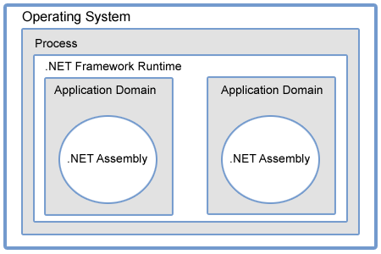
App Domain

Slide 55
// Creating Application Domain
AppDomain domain = AppDomain.CreateDomain("MyDomain");
// Loading Assembly in Application Domain
domain.ExecuteAssembly("../../TestAssembly.exe");
// Unload Application Domain
AppDomain.Unload(domain);

Slide 56
Application Domain Resource Monitoring
Application domain resource monitoring (ARM) enables hosts to monitor CPU and memory usage by application domain.
This is useful for hosts such as ASP.NET that use many application domains in a long-running process.
The host can unload the application domain of an application that is adversely affecting the performance of the entire process, but only if it can identify the problematic application.
ARM provides information that can be used to assist in making such decisions.

Slide 57
Application Domain Resource Monitoring
For example, a hosting service might have many applications running on an ASP.NET server.
If one application in the process begins consuming too much memory or too much processor time, the hosting service can use ARM to identify the application domain that is causing the problem.
ARM is sufficiently lightweight to use in live applications.
You can access the information by using event tracing for Windows (ETW) or directly through managed or native APIs.

Slide 58
Application Domain Resource Monitoring
<add key="AppDomainMonitoringEnabled" value="true"/>
<add key="FirstChanceExceptionMonitoringEnabled" value="true"/>

Slide 59
Application Domain Resource Monitoring
<add key="AppDomainMonitoringEnabled" value="true"/>
<add key="FirstChanceExceptionMonitoringEnabled" value="true"/>
AppDomain Monitoring

Slide 60
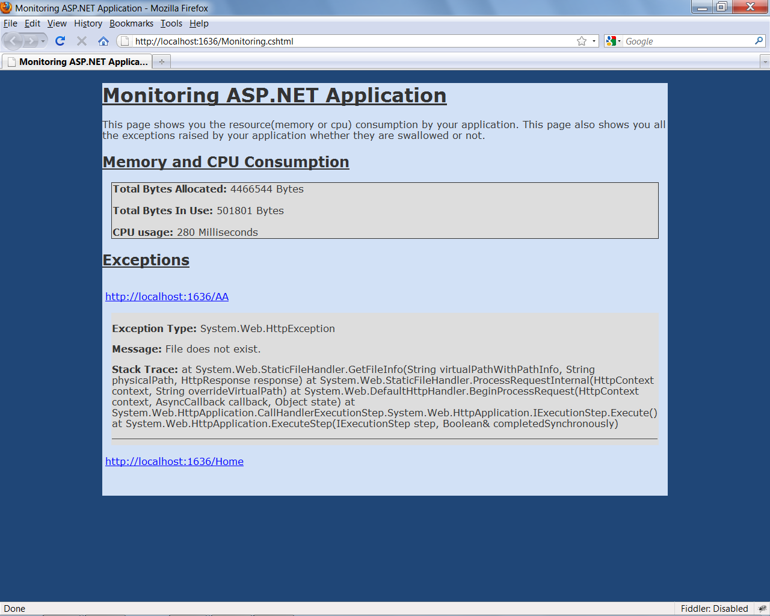
Application Domain Resource Monitoring

Slide 61
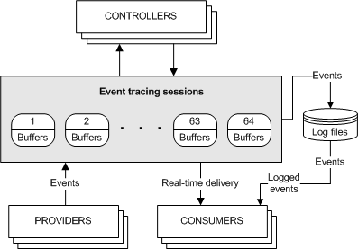

Slide 62
ETW
Event Tracing for Windows (ETW) is an efficient kernel-level tracing facility that lets you log kernel or application-defined events to a log file. You can consume the events in real time or from a log file and use them to debug an application or to determine where performance issues are occurring in the application.
ETW lets you enable or disable event tracing dynamically, allowing you to perform detailed tracing in a production environment without requiring computer or application restarts.
The Event Tracing API is broken into three distinct components:
Controllers, which start and stop an event tracing session and enable providers
Providers, which provide the events
Consumers, which consume the events

Slide 63
Application Domain Resource Monitoring
ARM can be enabled in four ways: by supplying a configuration file when the common language runtime (CLR) is started, by using an unmanaged hosting API, by using managed code, or by listening to ARM ETW events.
As soon as ARM is enabled, it begins collecting data on all application domains in the process.
If an application domain was created before ARM is enabled, cumulative data starts when ARM is enabled, not when the application domain was created.
Once it is enabled, ARM cannot be disabled.

Slide 64
Application Domain Resource Monitoring
You can enable ARM at CLR startup by adding the <appDomainResourceMonitoring> element to the configuration file, and setting the enabled attribute to true.
A value of false (the default) means only that ARM is not enabled at startup; you can activate it later by using one of the other activation mechanisms.

Slide 65
Application Domain Resource Monitoring
The host can enable ARM by requesting the ICLRAppDomainResourceMonitor hosting interface. Once this interface is successfully obtained, ARM is enabled.
Managed code can enable ARM by setting the static (Shared in Visual Basic) AppDomain.MonitoringIsEnabled property to true. As soon as the property is set, ARM is enabled.

Slide 66
Application Domain Resource Monitoring
You can enable ARM after startup by listening to ETW events.
ARM is enabled and begins raising events for all application domains when you enable the public provider Microsoft-Windows-DotNETRuntime by using the AppDomainResourceManagementKeyword keyword.
To correlate data with application domains and threads, you must also enable the Microsoft-Windows-DotNETRuntimeRundown provider with the Threading Keyword.

Slide 67
Using ARM
ARM provides the total processor time that is used by an application domain and three kinds of information about memory use.
Total processor time for an application domain, in seconds
Total managed allocations made by an application domain during its lifetime, in bytes
Managed memory, in bytes, that is referenced by an application domain and that survived the most recent full, blocking collection

Slide 68
Using ARM
Total managed memory, in bytes, that is referenced by the process and that survived the most recent full, blocking collection

Slide 69
Weak References
The garbage collector cannot collect an object in use by an application while the application's code can reach that object.
The application is said to have a strong reference to the object.
A weak reference permits the garbage collector to collect the object while still allowing the application to access the object.
A weak reference is valid only during the indeterminate amount of time until the object is collected when no strong references exist.
When you use a weak reference, the application can still obtain a strong reference to the object, which prevents it from being collected.
However, there is always the risk that the garbage collector will get to the object first before a strong reference is reestablished.

Slide 70
Weak References
Weak references are useful for objects that use a lot of memory, but can be recreated easily if they are reclaimed by garbage collection.
Suppose a tree view in a Windows Forms application displays a complex hierarchical choice of options to the user.
If the underlying data is large, keeping the tree in memory is inefficient when the user is involved with something else in the application.

Slide 71
Weak References
When the user switches away to another part of the application, you can use the WeakReference class to create a weak reference to the tree and destroy all strong references.
When the user switches back to the tree, the application attempts to obtain a strong reference to the tree and, if successful, avoids reconstructing the tree.

Slide 72
Weak References
To establish a weak reference with an object, you create a WeakReference using the instance of the object to be tracked.
You then set the Target property to that object and set the original reference to the object to null.
For a code example, see WeakReference in the class library.
the user switches away to another part of the application, you can use the WeakReference class to create a weak reference to the tree and destroy all strong references.
When the user switches back to the tree, the application attempts to obtain a strong reference to the tree and, if successful, avoids reconstructing the tree.

Slide 73
Short and Long Weak References
Short
The target of a short weak reference becomes null when the object is reclaimed by garbage collection.
The weak reference is itself a managed object, and is subject to garbage collection just like any other managed object.
A short weak reference is the default constructor for WeakReference.

Slide 74
Short and Long Weak References
Long
A long weak reference is retained after the object's Finalize method has been called.
This allows the object to be recreated, but the state of the object remains unpredictable.
To use a long reference, specify true in the WeakReference constructor.
If the object's type does not have a Finalize method, the short weak reference functionality applies and the weak reference is valid only until the target is collected, which can occur anytime after the finalizer is run.

Slide 75
Guidelines for Using Weak References
Use long weak references only when necessary as the state of the object is unpredictable after finalization.
Avoid using weak references to small objects because the pointer itself may be as large or larger.
Avoid using weak references as an automatic solution to memory management problems.
Instead, develop an effective caching policy for handling your application's objects.

Slide 76
Memory Leaks

Slide 77
Windows Memory Architecture
An application is made up of two things: the code itself, and the data that stores the state of the application during execution.
When a .NET application runs, four sections of memory (heaps) are created to be used for storage.
the Code Heap stores the actual native code instructions after they have been Just in Time compiled (JITed)
the Small Object Heap (SOH) stores allocated objects that are less than 85 K in size.
the Large Object Heap (LOH) stores allocated objects greater than 85 K
finally, there's the Process Heap.

Slide 78
Windows Memory Architecture
Everything on a heap has an address, and these addresses are used to track program execution and application state changes.
Applications are usually written to encapsulate code into methods and classes, so .NET has to keep track of chains of method calls as well as the data state held within each of those method calls.
When a method is called, it has its own cocooned environment where any data variables it creates exist only for the lifetime of the call.
A method can also get data from global/static objects, and from the parameters passed to it.

Slide 79
Windows Memory Architecture
In addition, when one method calls another, the local state of the calling method (variables, parameters) has to be remembered while the method to be called executes.
Once the called method finishes, the original state of the caller needs to be restored so that it can continue executing.
To keep track of everything (and there is often quite a lot of "everything") .NET maintains a stack data structure, which it uses to track the state of an execution thread and all the method calls made.

Slide 80
Windows Memory Architecture - Stack
Stack is used to keep track of a method's data from every other method call.
When a method is called, .NET creates a container (a stack frame) that contains all of the data necessary to complete the call, including parameters, locally declared variables and the address of the line of code to execute after the method finishes.
For every method call made in a call tree (i.e. one method that calls another, which calls another, and so on) stack containers are stacked on top of each other.
When a method completes, its container is removed from the top of the stack and the execution returns to the next line of code within the calling method (with its own stack frame).
The frame at the top of the stack is always the one used by the current executing method.

Slide 81
Windows Memory Architecture - Stack
Stack is used to keep track of a method's data from every other method call.
When a method is called, .NET creates a container (a stack frame) that contains all of the data necessary to complete the call, including parameters, locally declared variables and the address of the line of code to execute after the method finishes.
For every method call made in a call tree (i.e. one method that calls another, which calls another, and so on) stack containers are stacked on top of each other.
When a method completes, its container is removed from the top of the stack and the execution returns to the next line of code within the calling method (with its own stack frame).
The frame at the top of the stack is always the one used by the current executing method.

Slide 82
Windows Memory Architecture - Stack

Slide 83
Stack
The stack can store variables that are the primitive data types defined by .NET.
These include the following types

Slide 84
Heap
Instances of everything you have defined, including:
• classes
• interfaces
• delegates
• strings
• instances of "object“
... are all referred to as "reference types," and are stored on the heap (the SOH or LOH,
depending on their size).

Slide 85
Heap
When an instance of a reference type is created (usually involving the new keyword), only an object reference is stored on stack.
The actual instance itself is created on the heap, and its address held on the stack.

Slide 86
Passing parameters
When you pass a value type as a parameter, all you actually pass to the calling method is a copy of the variable.
Any changes that are made to the passed variable within the method call are isolated to the method.
Having copies of value types on the stack isn't usually a problem, unless the value type is large, as can be the case with structs.
While structs are value types and, as such, are also allocated onto the stack, they are also, by their nature, programmer-definable structures, and so they can get pretty large.

Slide 87
Passing parameters
When this is the case, and particularly if they are passed as parameters between method calls, it can be a problem for your application.
Having multiple copies of the same struct created on the stack creates extra work in copying the struct each time.
This might not seem like a big deal but, when magnified within a high iteration loop, it can cause a performance issue.

Slide 88
Passing parameters
One way around this problem is to pass specific value types by reference.
This is something you would do anyway if you wanted to allow direct changes to the value of a passed variable inside a method call. .

Slide 89
Boxing and unboxing
One way around this problem is to pass specific value types by reference.
This is something you would do anyway if you wanted to allow direct changes to the value of a passed variable inside a method call. .

Slide 90
Garbage collection
To achieve this automatic cleanup, .NET uses the famous (or perhaps infamous) garbage collector (GC).
All the GC does is look for allocated objects on the heap that aren't being referenced by anything.
The most obvious source of references, as we saw earlier, is the stack. Other potential sources include:
global/static object references
CPU registers
object finalization references (more later)
Interop references (.NET objects passed to COM/API calls)
stack references.
Collectively, these are all called root references or GC roots.

Slide 91
Garbage collection

Slide 92
Inspection and collection
To make sure objects which are no longer in use are cleared away, the GC simply gets a list of all root references and for each one, moves along its reference tree "marking" each object found as being in use.
Any objects not marked as being in use, or "live," are free to be "collected“
void Collect()
{
List gcRoots=GetAllGCRoots();
foreach (objectRef root in gcRoots)
{
Mark(root);
}
Cleanup();
}

Slide 93
Inspection and collection
Void Mark(objectRef o)
{
if (!InUseList.Exists(o))
{
InUseList.Add(o);
List refs=GetAllChildReferences(o);
foreach (objectRef childRef in refs)
{ Mark(childRef);
} } }

Slide 94
Inspection and collection
Void Mark(objectRef o)
{
if (!InUseList.Exists(o))
{
InUseList.Add(o);
List refs=GetAllChildReferences(o);
foreach (objectRef childRef in refs)
{ Mark(childRef);
} } }

Slide 95
SOH cleanup – heap compaction
Garbage collection of the Small Object Heap (SOH) involves compaction.
This is because the SOH is a contiguous heap where objects are allocated consecutively on top of each other.
When compaction occurs, marked objects are copied over the space taken up by unmarked objects, overwriting those objects, removing any gaps, and keeping the heap contiguous; this process is known as Copy Collection.
The advantage of this is that heap fragmentation (i.e. unusable memory gaps) is kept to a minimum.
The main disadvantage is that compaction involves copying chunks of memory around, which requires CPU cycles and so, depending on frequency, can cause performance problems.
What you gain in efficient allocation you could lose in compaction costs.

Slide 96
LOH sweeping – free space tracking
The Large Object Heap (LOH) isn't compacted, and this is simply because of the time it would take to copy large objects over the top of unused ones.
Instead, the LOH keeps track of free and used space, and attempts to allocate new objects into the most appropriately-sized free slots left behind by collected objects.
As a result of this, the LOH is prone to fragmentation, wherein memory gaps are left behind that can only be used if large objects (i.e. >85 KB) of a similar or smaller size to those gaps are subsequently allocated.

Slide 97
Consecutive allocation on the SOH
In unmanaged C/C++ applications, objects are allocated onto the heap wherever space can be found to accommodate them.
When an object is destroyed by the programmer, the space that that object used on the heap is then available to allocate other objects onto.
The problem is that, over time, the heap can become fragmented, with little spaces left over that aren't usually large enough to use effectively.
As a result, the heap becomes larger than necessary, as more memory segments are added so that the heap can expand to accommodate new objects.

Slide 98
Consecutive allocation on the SOH
Another problem is that whenever an allocation takes place (which is often), it can take time to find a suitable gap in memory to use.
To minimize allocation time and almost eliminate heap fragmentation, .NET allocates objects consecutively, one on top of another, and keeps track of where to allocate the next object.

Slide 99
Consecutive allocation on the SOH
Another problem is that whenever an allocation takes place (which is often), it can take time to find a suitable gap in memory to use.
To minimize allocation time and almost eliminate heap fragmentation, .NET allocates objects consecutively, one on top of another, and keeps track of where to allocate the next object.

Slide 100
Consecutive allocation on the SOH

Slide 101
Consecutive allocation on the SOH
The GC runs automatically on a separate thread under one of the conditions below.
• When the size of objects in any generation reaches a generation-specific threshold.
To be precise, when:
• Gen 0 hits ~256 K
• Gen 1 hits ~ 2 MB (at which point the GC collects Gen 1 and 0)
• Gen 2 hits ~10 MB (at which point the GC collects Gen 2, 1 and 0)
• GC.Collect() is called in code
• the OS sends a low memory notification.

Slide 102
Consecutive allocation on the SOH
Gen 0 collection
Gen 0 objects have never been looked at by the GC before, so they have two possible options when they are finally inspected:
move to Gen 1 (if they have a root reference in their hierarchy)
die and be compacted (if they are rootless and therefore no longer in use).

Slide 103
Consecutive allocation on the SOH
Gen 0 collection

Slide 104
Consecutive allocation on the SOH
Gen 1 collection

Slide 105
Consecutive allocation on the SOH
Gen 2 collection

Slide 106
Performance implications
In an ideal world, the vast majority of your objects should die in Gen 0, or possibly Gen 1.
Objects that make it to Gen 2 should do so for a specific reason; probably because they're reusable objects that it is more efficient to create once and keep, rather than recreate each time.
If an object makes it to Gen 2, it's often (or should be) because it's actually needed.
Unfortunately, you can, and will, write code where objects make it to Gen 2 only to then immediately lose their root reference.
This means that they are not in use, but are potentially going to stick around and take up valuable space.
In addition, if this is code that runs frequently during execution, it means that Gen 2 GC is going to happen a lot more frequently.

Slide 107
Finalization

Slide 108
Finalization
If you write classes that access unmanaged resources such as files/disks, network resources, UI elements or databases, then you have probably done the decent thing and written cleanup code in your classes to close and destroy the used resources.
Any unmanaged resource accessed from .NET won't be cleaned up by the GC and so will be left behind.
If you put a destructor or a Finalize method in your class, then you will actually extend the lifetime of instances of your classes for longer than you expect.

Slide 109
Finalization
class TestClass
{
~TestClass()
{
}
}
class TestClass2
{
void Finalize()
{
}
}

Slide 110
Finalization
Finalize is a special method that is automatically called by the garbage collector (GC) before the object is collected.
This method is only called by the GC. The destructor in C# is automatically translated into Finalize.
You can see the IL code using IDASM where you will see that destructor is renamed to finalize.

Slide 111
Finalization
public class A
{
~A()
{
Console.WriteLine("Class A Destructor");
//Clean up unmanaged resources here
}
}

Slide 112
Finalization
public override void Finalize()
{
try
{
Console.WriteLine("Class A Destructor");
//Clean up unmanaged resources here
}
finally
{
base.Finalize();
}
}

Slide 113
Fundamental of Finalization
When a new object is created, the memory is allocated in the managed heap.
If newly created object have a Finalize() method or a destructor then a pointer pointing to that object is put into the finalization queue.
Basically, finalization queue is an internal data structure that is controlled and managed by the GC.
Hence each pointer in finalization queue points to an object that have its Finalize method call before the memory is reclaimed.

Slide 114
Fundamental of Finalization
When a new object is created, the memory is allocated in the managed heap.
If newly created object have a Finalize() method or a destructor then a pointer pointing to that object is put into the finalization queue.
Basically, finalization queue is an internal data structure that is controlled and managed by the GC.
Hence each pointer in finalization queue points to an object that have its Finalize method call before the memory is reclaimed.
In the below fig. the managed heap contains 10 objects and objects 2,3,5,6,and 10 also contains the Finalize method. Hence pointers to these objects were added to the finalization queue.

Slide 115
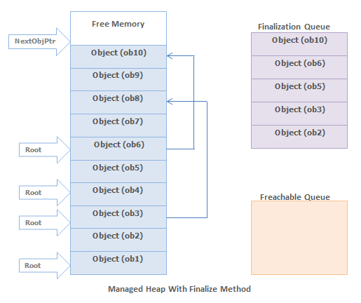
Fundamental of Finalization

Slide 116
Fundamental of Finalization
When the garbage collector starts go through the roots, it make a graph of all the objects reachable from the roots.
The below fig. shows a heap with allocated objects. In this heap the application roots directly refer to the objects 1,3,4,6 and object 3 & 6 refers to the objects 8 & 10.
Hence all these objects will become the part of the live objects graph.

Slide 117
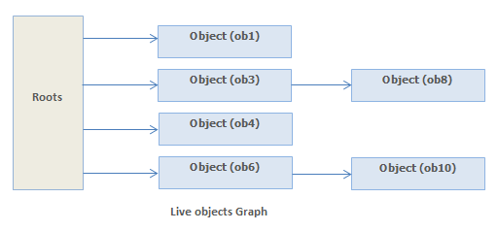
Fundamental of Finalization

Slide 118
Fundamental of Finalization
The objects which are not reachable from application's roots, are considered as garbage since these are not accessible by the application.
In above heap objects 2,5,7,9 will be considered as dead objects.
Before the collections for dead objects, the garbage collector looks into the finalization queue for pointers identifies these objects.
If the pointer found, then the pointer is flushed from the finalization queue and append to the freachable queue .
The freachable queue is also an internal data structure and controlled by the garbage collector.
Now each and every pointer with in the freachable queue will identify an object that is ready to have its Finalize method called.

Slide 119
Fundamental of Finalization
After the collection, the managed heap looks like below Fig.
Here, you see that the memory occupied by objects 7 and 9 has been reclaimed because these objects did not have a Finalize method.
However, the memory occupied by objects 2 and 5 could not be reclaimed because their Finalize method has not been called yet.

Slide 120
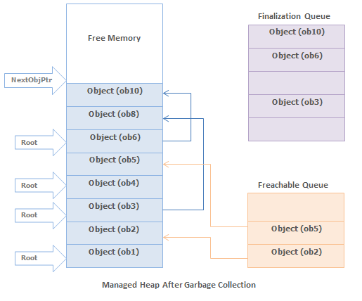
Fundamental of Finalization

Slide 121
Fundamental of Finalization
When an object's pointer entry move from the finalization queue to the freachable queue, the object is not considered garbage and its memory is not reclaimed.
There is a special run-time thread that is dedicated for calling Finalize methods.
When there is no entry in the freachable queue then this thread sleeps.
But when there is entry in the freachable queue, this thread wakes and removes each entry from the queue by calling each object's Finalize method.

Slide 122
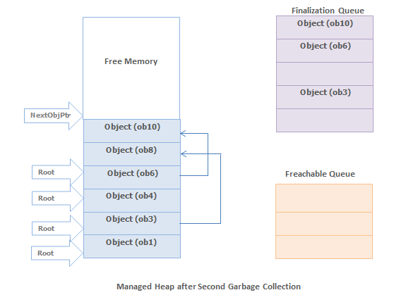
Fundamental of Finalization
The next time the garbage collector is invoked, it sees that the finalized objects are truly garbage, since the application's roots don't point to it and the freachable queue no longer points to it. Now the memory for the object is simply reclaimed.
The two GCs are required to reclaim memory used by objects that have Finalize method.

Slide 123
Finalization
Microsoft took a different approach, and decided to call the finalizer on objects asynchronously and on a dedicated thread.
This runs periodically and calls the finalizer on all applicable objects, entirely independently of the GC.
However, that creates a new puzzle: how do you prevent an object that needs finalization from being compacted before its finalizer is called?
The answer they came up with was to keep a queue of extra root references to all finalizable objects (one reference per object) and use this to keep them alive long enough to call their finalizer.

Slide 124
Finalization

Slide 125
Reclaiming GC Memory

Slide 126
Reclaiming GC Memory
The managed heap is a series of allocated memory segments (approx 16Mb in size each) to store and manage objects.
The memory for newly created object is allocated at the next available location on the managed heap.
If there is available free memory, the garbage collector doesn't search the dead objects for memory reclaim and memory allocations has been done very fast.
If the memory is insufficient to create the object, the garbage collector search the dead objects for memory reclaim for the newly object.

Slide 127
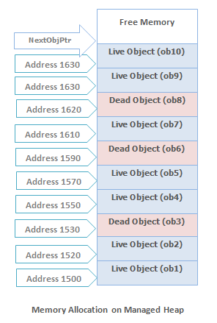
Reclaiming GC Memory

Slide 128
Reclaiming GC Memory
An object is created using the new operator.
This operator first makes sure that the bytes required by the new object fit in the reserved region (committing storage if necessary).
If the object fits, NextObjPtr points to the object in the heap and object's constructor is called and the new operator returns the address of the object.

Slide 129
Key points about Garbage Collector
All objects in the heap are allocated from one contiguous range of memory address and heap is divided into generations so that it is easy to eliminate the garbage objects by looking at only a small fraction of the heap.
Gen 0 and Gen 1 occupy a single segment known as the ephemeral segment. Gen 2 is a set of further segments and the large object heap is yet another group of segments.
Almost, all objects with-in a generation are of the same age.
The newest objects are created at higher memory address while oldest memory objects are at lowest memory address with in the heap.

Slide 130
Key points about Garbage Collector
The allocation pointer for the new objects marks the boundary between the allocated and free memory.
Periodically the heap is compacted by removing the dead objects and sliding up the live objects towards the lower memory address end of the heap as shown in above fig.
The order of objects (after memory reclaims) in memory remains the same as they were created.
There are never any gaps among the objects in the heap.
Only some of the free memory is committed when required and more memory is acquired from the OS in the reserved address range.

Slide 131
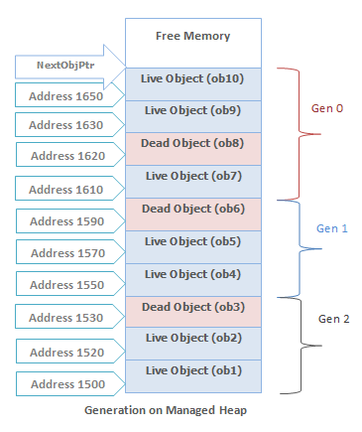
Generations in Managed Heap
The managed heap is organized into three generations so that it can handle short lived and long lived objects efficiently.
Garbage collector first reclaim the short lived objects that occupy a small part of the heap.

Slide 132
Generations in Managed Heap
Generation 0
This is the youngest generation and contains the newly created objects. Generation 0 has short-lived objects and collected frequently. The objects that survive the Generation 0 are promoted to Generation 1.
Example : A temporary object.
Generation 1
This generation contains the longer lived objects that are promoted from generation 0. The objects that survive the Generation 1 are promoted to Generation 2. Basically this generation serves as a buffer between short-lived objects and longest-lived objects.

Slide 133
Generations in Managed Heap
Generation 2
This generation contains the longest lived objects that are promoted from generation 1 and collected infrequently.
Example : An object at application level that contains static data which is available for the duration of the process.

Slide 134
Garbage Collector Working Phase
Marking Phase
In this phase garbage collector finds and creates a list of all live objects.
Relocating Phase
In this phase garbage collector updates the references to the objects that will be compacted.
Compacting Phase
In this phase garbage collector reclaims the memory occupied by the dead objects and compacts the surviving objects. The compacting phase moves the surviving objects toward the older end of the memory segment.

Slide 135
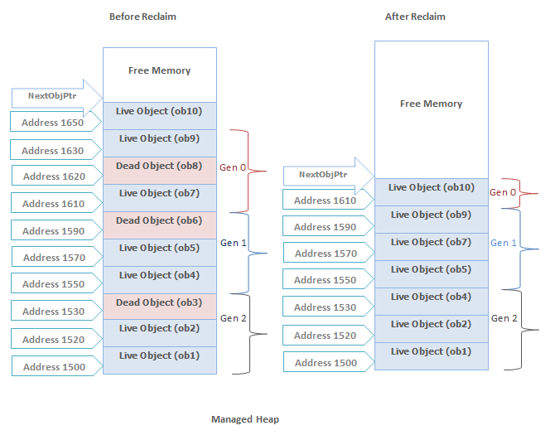
Garbage Collector Working Phase
The large object heap is not compacted, because copying large objects imposes a performance penalty.

Slide 136
Garbage Collection Algorithm
Garbage collector determine whether any object in the heap is dead or not being used by the application.
If such objects exist then memory used by these objects can be reclaimed. But how garbage collector know about these objects?
Each and every application has a set of roots and these identify the storage locations for the objects on the managed heap.

Slide 137
Garbage Collection Algorithm
Example : All the global, static objects pointers and all the local variable/ parameter object pointers on the thread's stack in the application are considered part of the application's roots.
More over any CPU registers containing pointers to objects in the managed heap are also considered a part of the application's roots.
The list of active roots is maintained by the JIT compiler and CLR, and is made accessible to the garbage collector's algorithm.

Slide 138
Memory Reclaim Process
Now the garbage collector starts go through the roots and make a graph of all the objects reachable from the roots.
The below fig. shows a heap with allocated objects.
In this heap the application roots directly refer to the objects 1,3,4,6 and object 3 & 6 refers to the objects 8 & 10.
Hence all these objects will become the part of the live objects graph.

Slide 139
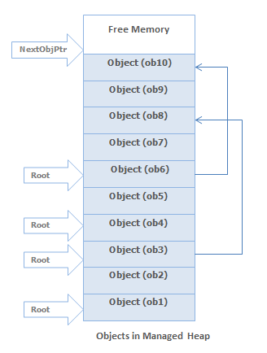
Memory Reclaim Process

Slide 140
Memory Reclaim Process
The objects which are not reachable from application's roots, are considered as garbage since these are not accessible by the application.
In above heap objects 2,5,7,9 will be considered as dead objects.

Slide 141
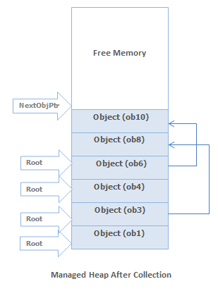
Memory Reclaim Process
The garbage collector then remove the dead objects from the heap and live objects will move toward the older end of the memory segment as shown in below fig.
Garbage collector also updates all the references(including root references) to the moving objects in the heap.

Slide 142
Garbage Collection Modes

Slide 143
Garbage Collection Modes
The Garbage Collector in the CLR is a very complicated, configurable and self-tuning creature that may change behavior based on application needs.
To satisfy different memory usage requirements the GC has some options to configure how it operates.
There are two main modes: Workstation mode (designed to minimize delays) and Server mode (designed for maximum application throughput).
The GC also supports one of two “sub-modes” - concurrent or non-concurrent (**).

Slide 144
Garbage Collection Modes
When the CLR starts, it selects a GC mode and this mode cannot change during the lifetime of the process.
There are two basic modes
Workstation
Fine tunes the GC for the client-side application and optimized to provide for low-latency GCs in order to minimize the time an application’s threads are suspended, so that it does not affect the end user.
GC assumes that the other applications are running on the machine and does not hold CPU resources.

Slide 145
Garbage Collection Modes
Server
Fine tune the GC for server-side application and optimized for throughput and resource utilization.
In this mode, GC assumes no other applications are running on the machine and it assumes that all the CPUs on the machine are available to assist the GC
By default, the application runs on Workstation Mode.
If the server application is running on the uniprocessor machine, then the CLR will always use Workstation mode GC.
A Server application that host the CLR can request the CLR to load the Server GC.

Slide 146
Garbage Collection Modes
Workstation GC vs. Server GC
Workstation GC is designed for desktop applications to minimize the time spent in GC.
In this case GC will happen more frequently but with shorter pauses in application threads.
Server GC is optimized for application throughput in favor of longer GC pauses.
Memory consumption will be higher, but application can process greater volume of data without triggering garbage collection.

Slide 147
Garbage Collection Modes
All managed objects are stored in segments.
There is one segment for young generations (called the ephemeral segment) and many segments for generation 2 and large object heap.
When the ephemeral segment is full, CLR will allocate a new one.
But before that, GC will happen. The size of the segment varies depending on whether a system is 32- or 64-bit, and on the type of the garbage collector.
Workstation GC uses smaller segments and Server GC uses bigger segment, although the size depends on the number of CPU cores.

Slide 148
Garbage Collection Modes
Smaller the segments are more frequently GC will occur.
Workstation GC is used by default in all managed apps and is best suited for UI applications.
Server GC could be turned on by the CLR host or configured in <gcServer> element in the application configuration file and intended for server applications.

Slide 149
Garbage Collection Modes
GC flavors like ‘concurrent’ or ‘non-concurrent’ may help fine tune the garbage collection to gain maximum performance and/or responsiveness for your application.
Concurrent mode reduces the overall time spent in GC because the mark phase for 2nd generation happens in dedicated thread in parallel with application threads.
In this mode, GC suspends user threads for shorter amount of time but will use slightly more memory.

Slide 150
Garbage Collection Modes
Concurrent Workstation GC is best suited for UI applications.
Non-concurrent Workstation GC should be used for lightweight server processes or for server apps on single-core machines.
To visualize the GC, I’ll be using a tool called Concurrency Visualizer, observing a simple console application.
Concurrency Visualizer is a Visual Studio extension that shows various threading aspects of the application, like lock contention, thread synchronization, input-output operations, GC pauses and other.
The app is simply allocates byte arrays. Some arrays are kept in the internal lists and some of them are eligible for garbage collection immediately.

Slide 151
Workstation GC: non-concurrent mode
There are a few reasons for GC to happen: Generation 0 is full or Gen0 budget is reached, GC.Collect was called, or the system memory is low. We are only interested in the first option.
Here is a very rough algorithm for workstation non-concurrent GC:
Application thread allocates an object and GC can’t fulfill the request. GC is started.
CLR suspends all managed threads.
CLR collects the garbage in the thread that triggered the GC.
CLR resumes all application threads once GC is done.

Slide 152
Workstation GC: concurrent mode
In concurrent (or background) mode, the CLR creates a dedicated high-priority thread for Gen2 collection.
In this case, the first phase of the garbage collection, mark phase, is happening in parallel with application threads.
During this phase the application is still running, so user threads can allocate new objects and even trigger GC for young generations.
This is the main difference between old Concurrent GC available in pre .NET 4.0 era and the new Background GC.
Concurrent GC also had a dedicated worker thread for Gen2 collection, but unlike Background GC if a user thread triggered GC, the thread was blocked while current GC is in progress.
Background GC allows ephemeral collection in the middle of the background one.
Background GC supersedes Concurrent GC and the same key is used to turn it on. In .NET 4.0+ there is no way to use Concurrent GC any more.

Slide 153
Workstation GC: concurrent mode
Here is how GC looks like for background Workstation GC:
Application thread allocates an object and GC can’t fulfill the request. GC is started.
CLR suspends all managed threads.
CLR collects Gen0 and Gen1.
CLR starts background collection and resumes all managed threads.
Background thread marks all reachable objects in memory and suspends application threads for sweep or compact phase.
CLR resumes all application threads once GC is done.

Slide 154
Server GC
Server GC has a few very important aspects that affect garbage collection:
1. Server GC is using bigger segments (few times bigger than for workstation GC).
2. The CLR creates 1 managed heap per core. This means that for an 8 core machine, the CLR will allocate 8 distinct managed heaps.
3. GC happens in dedicated threads: one thread per managed heap.
Server GC trades memory in favor of throughput. Larger heaps mean that memory saturation happens less frequently, but once it happens, the CLR needs to do more work to traverse the heap.
As a result, the application consumes more memory and GC will happen less frequently, but every GC will take longer period of time even for collecting Gen0 and Gen1.

Slide 155
Server GC
To speed up the GC CLR is uses a dedicated high priority thread even for ephemeral collection.
In the case of background GC the CLR will create yet another set of threads (one per core) for background analysis.
Managed applications with background server GC will use 16 additional threads for an 8 core machine!

Slide 156
Server GC
The basic workflow for Background Server GC is as following:
Application thread allocates an object and GC can’t fulfill the request. GC is started.
CLR suspends all managed threads.
CLR collects Gen0 and Gen1 in dedicated GC worker threads.
CLR suspends GC worker threads and starts background collection. All the managed threads are resumed.
Background threads mark all reachable objects in memory and suspend application threads for sweep or compact phase.
CLR resumes GC worker threads to sweep the heap.
Application threads wait for GC to finish.

Slide 157
GC Mode | E2E time (ms) | Total GC Pause (ms) | % Time paused for GC | Gen0Count | Gen1 Count | Gen2 Count | Total Allocations (Mb) | Max GC Heap Size (Mb)
Workstation GC | 132 765 | 46 118 | 35.1% | 1674 | 1439 | 35 | 174 691 | 1 561
Background Workstation GC | 132 008 | 39 798 | 30.4% | 2109 | 1451 | 65 | 225 554 | 1 676
Server GC | 102 553 | 9 026 | 9.1% | 28 | 130 | 8 | 17 959 | 1 667
Background Server GC | 99 867 | 8 040 | 8.5% | 23 | 148 | 9 | 16 610 | 1 724

Slide 158
Definition of Memory Leak

Slide 159
Leaking Memory
The .Net garbage collector is supposed to take care of memory management but it only releases memory that is unreachable.
If an application still has a reference to an object then it won’t be released.
Therefore, there’s still plenty of scope for writing a leaky application in the .Net framework.
Developers do need to be aware of what’s going on under the hood as there are a number of common traps for the unwary.

Slide 160
Leaking Memory
Static references
Objects that are referenced by static fields are never released.
This may seem straightforward, but it also applies to any objects that are indirectly referred to by a static field.
If you don’t pay attention to indirect references then you may get an ever-increasing chain of object references building up.
They will hang around for ever because the root reference at the start of the chain is static.

Slide 161
Leaking Memory
Events and “lapsed listeners”
The .Net event model is based on creating subscriptions to events, much like the code below:
obj.Changed += new ChangedEventHandler(sender);
This causes the event publisher to maintain a reference to the subscriber.
This becomes a leak if the subscriber fails to explicitly unsubscribe from the publisher.
The subscriber object cannot be released and the publisher is left broadcasting to a “zombie” object that is no longer required.

Slide 162
Leaking Memory
One solution to this problem is using a weak reference that allows the garbage collector to release the object while the application reference still exists.
However, Microsoft recommend against using this as a default solution to memory management problems.
Ultimately, more robust management of event subscriptions is the preferred approach to avoiding leaks through lapsed listeners.

Slide 163
Leaking Memory
Incorrect or missing clean-up code
The garbage collector doesn’t free .Net developers from the responsibility of cleaning up after themselves.
This is what the IDisposable interface is for.
If it’s been implemented then it’s a signal that there’s something that needs to be cleaned up and it should always be called on completion.
This is particularly the case for resources that run in the unmanaged heap where the garbage collector is not responsible for clean-up.
Any resources that run outside of the .Net framework such as database connections, file handles and COM objects are unmanaged so must be disposed of explicitly.

Slide 164
Leaking Memory
It’s surprising how often developers forget to do this but it’s probably the single most important responsibility developers have in resource management.
Any application that uses unmanaged resources will drown at scale if the clean-up code isn’t being called properly.

Slide 165
Leaking Memory
Dead threads
Poor thread management can also be a source of leaks.
The garbage collector is not responsible for cleaning up the stack as any space reserved is automatically cleaned up when methods return.
However, you can cause Stack leaks through poor thread management.
If an application creates worker threads for background tasks and does not terminate them properly then the memory that is used by the thread is never released.

Slide 166
Leaking Memory
Refer Code Thread Poor Management
With each iteration of the loop the Thread object reference is dropped but the actual managed thread remains.
If you track the memory usage for the application you’ll see it slowly moving up with each new thread as memory on the Stack fails to get released.

Slide 167
Leaking Memory
Large object fragmentation
.Net manages memory in two main areas knows as heaps.
One is reserved for small objects and is regularly compacted to ensure optimal memory usage.
If an object is 85k or larger then it is allocated onto the “large” object heap.
This part of managed memory is not compacted automatically due to the cost of moving larger objects.
The framework just adds objects to this memory wherever it finds some free space.
As these larger objects are allocated and freed, gaps inevitably start to appear in the large object heap.
Memory use becomes much less efficient and under certain circumstances this can cause “out of memory” exceptions as the heap becomes hopelessly fragmented.

Slide 168
Leaking Memory
This fragmentation depends very much on your usage pattern but the more extreme manifestations tend to be associated with long-running processes that make frequent updates to large memory objects.
Recent additions to the .Net framework allow you to initiate a clean-up of large heap fragmentation but it still remains the responsibility of the developer to be aware of memory allocation for large objects.

Slide 169
Leaking Memory
Poor resource management
Ultimately you have finite resources so you should get used to the discipline of only using memory when you have to.
If you hold onto a variable unnecessarily then you are preventing the garbage collector from freeing up memory as quickly as possible.
It’s one more item that has to be managed through the heap.
This may seem insignificant but it can start to make a difference if you hold on to too much unnecessary data through long-running operations.

Slide 170
Leaking Memory
Poor resource management
Poorly designed applications inevitably have larger memory footprints than is strictly necessary.
State buckets such as session caches encourage developers to create unnecessary and long-lived memory dumps.
Over-aggressive caching can start to resemble to symptoms of a memory leak.
Although the details of memory management may be largely hidden from developers, they still have a responsibility to protect finite memory resources and code as efficiently as possible.

Slide 171
Leak Detection Tool
1. Detect a Memory Leak problem with the Diagnostic Tool Window
If you go to Debug | Windows | Show Diagnostic Tools, you’ll see this window. If you’re like me, you probably saw this tool window after installing Visual Studio, closed it immediately, and never thought of it again. The Diagnostic Tools Window can be quite useful though. It can easily help you detect 2 problems: Memory Leaks and GC Pressure.
When you have Memory Leaks, the Process Memory graph looks like this:

Slide 172
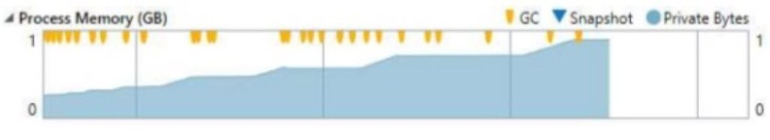
Leak Detection Tool
You can see with the yellow lines coming from the top that the GC is trying to free memory, but it still keeps rising.

Slide 173
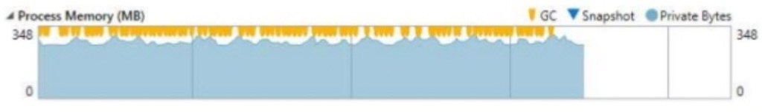
Leak Detection Tool
When you have GC Pressure, the Process Memory graph looks like this:
GC Pressure is when you are creating new objects and disposing of them too quickly for the garbage collector to keep up. As you see in the picture, the memory is close to its limit and the GC bursts are very frequent.

Slide 174
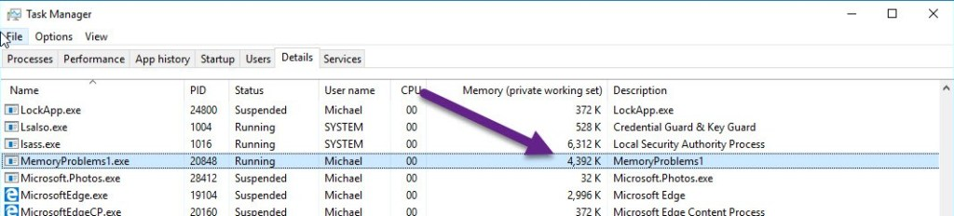
Leak Detection Tool
Detect Memory Leak problems with the Task Manager, Process Explorer or PerfMon
The second easiest way to detect major memory leak problems is with the Task Manager or Process Explorer (from SysInternals). These tools can show the amount of memory your process uses. If it consistently increases over time, you probably have a memory leak.

Slide 175
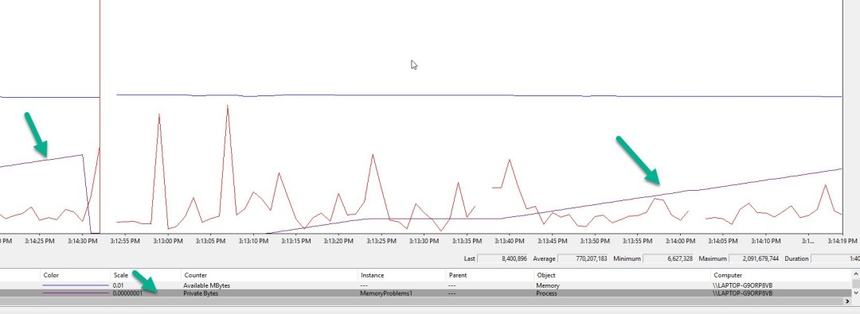
Leak Detection Tool
PerfMon is a bit harder to use but can show a nice graph of your memory usage over time. Here’s a graph of my application that endlessly allocates memory without freeing it. I’m using the Process | Private Bytes counter.

Slide 176
Leak Detection Tool
Use a memory profiler to detect memory leaks
The quickest and most useful profiling technique is to compare 2 snapshots where the memory should return to the same state.
The first snapshot is taken before an operation, and another snapshot is taken after the operation.
The exact steps are:
Start with some kind of Idle state in your application. This could be the Main Menu or something similar.
Take a snapshot with the Memory profiler by attaching-to-process or saving a Dump.
Run an operation where you suspect a memory leak is created. Return to the Idle state at the end of it.
Take a second snapshot.
Compare both snapshots with your memory profiler.
Investigate the New-Created-Instances, they are probably memory leaks. Examine the “path to GC Root” and try to understand why those objects weren’t freed.

Slide 177
Leak Detection Tool
Add Telemetry from Code
PerformanceCounter ctr1 = new PerformanceCounter("Process", "Private Bytes", Process.GetCurrentProcess().ProcessName);
PerformanceCounter ctr2 = new PerformanceCounter(".NET CLR Memory", "# Gen 0 Collections", Process.GetCurrentProcess().ProcessName);
PerformanceCounter ctr3 = new PerformanceCounter(".NET CLR Memory", "# Gen 1 Collections", Process.GetCurrentProcess().ProcessName);
PerformanceCounter ctr4 = new PerformanceCounter(".NET CLR Memory", "# Gen 2 Collections", Process.GetCurrentProcess().ProcessName);
PerformanceCounter ctr5 = new PerformanceCounter(".NET CLR Memory", "Gen 0 heap size", Process.GetCurrentProcess().ProcessName);
//...
Debug.WriteLine("ctr1 = " + ctr1 .NextValue());
Debug.WriteLine("ctr2 = " + ctr2 .NextValue());
Debug.WriteLine("ctr3 = " + ctr3 .NextValue());
Debug.WriteLine("ctr4 = " + ctr4 .NextValue());
Debug.WriteLine("ctr5 = " + ctr5 .NextValue());

Slide 178
Leak Detection Tool
Test for Memory Leak
[Test]
void MemoryLeakTest()
{
var weakRef = new WeakReference(leakyObject)
// Ryn an operation with leakyObject
GC.Collect();
GC.WaitForPendingFinalizers();
GC.Collect();
Assert.IsFalse(weakRef.IsAlive);

Slide 179
ANTS Profiler Features
NEW: Profile your SQL queries and see execution plansFrom .NET code to database. View performance data for both your .NET code and database requests made by the .NET code. Profile database requests your application makes to any SQL Server, Oracle, MySQL (or MariaDB), and PostgreSQL database. This is ideal if you're using an ORM.
Understand web requests. View rich data about outbound HTTP requests made by your application, including request and response header information. See all the information in the context of the .NET code which caused the request to run.
File I/O performance. Get comprehensive performance information on your application's disk activity.
Jump straight to the slowest activity. The call tree shows performance data for every method and identifies the most expensive methods, database queries, and web requests.
Drill down to slow lines of code with line-level timings. Profile C# or any other .NET code line by line, with precise timing data so you can find issues at a glance. Expensive lines of code are automatically highlighted for quick visual inspection.

Slide 180
ANTS Profiler Features
Look at your code's database interaction. Understand how your .NET code makes database queries and how those queries perform. ANTS Performance Profiler supports SQL Server and Oracle databases, whether local or remote. (Only available in Pro edition)
Capture outgoing web requests. Look at your application's outgoing HTTP requests. Get data about the request and response headers, and see what .NET code caused them to run. (Only available in Pro edition)
Immediate feedback on application performance. Use the interactive timeline to check the CPU usage of your .NET or ASP.NET application and highlight problem areas to focus only on the data that matters.
Group methods by HTTP request. Code and database activity are grouped by HTTP request, exposing performance problems on specific web pages. (Only available in Pro edition)

Slide 181
ANTS Profiler Features
Profile async code. Understand the performance of C#5 async code. View activity in the context of the code you wrote, and see how work being done asynchronously is related to the async method which caused it to run.
Decompile third-party code. Find bottlenecks in third-party components and framework assemblies using integrated decompilation, powered by .NET Reflector. (Only available in Pro edition)
Profile SQL queries. Relate timings for your individual lines of .NET code right through to the SQL execution plans. Find out exactly why your SQL query is running slow.

Slide 182
.NET Memory Profiler
Features

Slide 183
Performance Tool | Windows desktop | UWP | ASP.NET/ASP.NET Core
CPU Usage | yes | yes | yes
Memory Usage | yes | yes | yes
GPU Usage | yes | yes | no
Application Timeline | yes | yes | no
PerfTips | yes | yes for XAML, no for HTML | yes
Performance Explorer | yes | no | yes
IntelliTrace | .NET with Visual Studio Enterprise only | .NET with Visual Studio Enterprise only | .NET with Visual Studio Enterprise only
Network Usage | no | yes | no
HTML UI responsiveness | no | yes for HTML, no for XAML | no
JavaScript Memory | no | yes for HTML, no for XAML

Slide 184
Dump Analysis
Dump Files
A dump file is a snapshot that shows the process that was executing and modules that were loaded for an app at a point in time.
A dump with heap information also includes a snapshot of the app's memory at that point.
Opening a dump file with a heap in Visual Studio is something like stopping at a breakpoint in a debug session.
Although you can't continue execution, you can examine the stacks, threads, and variable values of the app at the time of the dump.

Slide 185
Dump Analysis
Dumps are mostly used to debug issues from machines that developers don't have access to.
You can use a dump file from a customer's machine when you can't reproduce a crash or hang on your own machine.
Testers also create dumps to save crash or hang data to use for more testing.
The Visual Studio debugger can save dump files for managed or native code.
It can debug dump files created by Visual Studio or by other apps that save files in the minidump format.

Slide 186
Dump Analysis
Requirements and limitations
To debug dump files from 64-bit machines, Visual Studio must be running on a 64-bit machine.
Visual Studio can debug dump files of native apps from ARM devices.
It can also debug dumps of managed apps from ARM devices, but only in the native debugger.
To debug kernel-mode dump files or use the SOS.dll debugging extension in Visual Studio, download the debugging tools for Windows in the Windows Driver Kit (WDK).

Slide 187
Dump Analysis
Visual Studio can't debug dump files saved in the older, full user-mode dump format.
A full user-mode dump is not the same as a dump with heap.
Debugging dump files of optimized code can be confusing.
For example, compiler inlining of functions can result in unexpected call stacks, and other optimizations might change the lifetime of variables.

Slide 188
Dump Analysis
Dump files with or without heaps
Dump files may or may not have heap information.
Dump files with heaps contain a snapshot of the app's memory, including the values of variables, at the time of the dump.
Visual Studio also saves the binaries of loaded native modules in a dump file with a heap, which can make debugging much easier.
Visual Studio can load symbols from a dump file with a heap, even if it can't find an app binary.

Slide 189
Dump Analysis
Dump files without heaps are much smaller than dumps with heaps, but the debugger must load the app binaries to find symbol information.
The loaded binaries must exactly match the ones running during dump creation.
Dump files without heaps save the values of stack variables only.

Slide 190
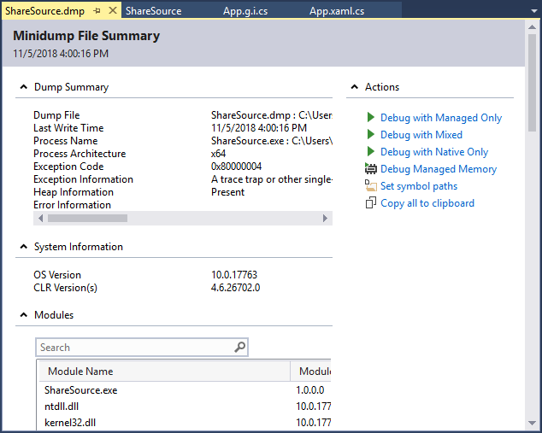
Dump Analysis

Slide 191
ProcDump
Launch procdump.exe with the appropriate arguments for your scenario. Below I list a few of the most common arguments, however a full list is available on the ProcDump page):
-e Write a dump when the process encounters an unhandled exception.
-h Write dump if process has a hung window (does not respond to window messages for at least 5 seconds).
-ma Write a dump file with all process memory. The default dump format includes thread and handle information.
-x Launch the specified application
-g Run as a native debugger in a managed process (required for collecting dumps from processes running .NET code)

Slide 192
ProcDump
Procdump –ma process id

Slide 193
Dump Analysis
Under Actions:
To set symbol loading locations, select Set symbol paths.
To start debugging, select Debug with Managed Only, Debug with Native Only, Debug with Mixed, or Debug with Managed Memory.

Slide 194
Dump Analysis
Find .exe, .pdb, and source files
To use full debugging features on a dump file, Visual Studio needs:
The .exe file the dump was created for, and other binaries (DLLs, etc.) that the dump process used.
Symbol (.pdb) files for the .exe and other binaries.
The .exe and .pdb files that exactly match the version and build of the files at dump creation.
Source files for the relevant modules. You can use the disassembly of the modules if you can't find the source files.

Slide 195
Debuggers
Overview of Debuggers
A brief overview of the Windows debuggers that you can download for free from here:
KD – Kernel debugger. You want to use this to remote debug OS problems like blue screens.
You want it if you develop device drivers.
CDB – Command-line debugger. This is a console application.
NTSD – NT debugger. This is a user-mode debugger that you can use to debug your user-mode applications. Effectively, this is Windows-style UI added to CDB.
Windbg – wraps KD and NTSD with a decent UI. WinDbg can function both as a kernel-mode and user-mode debugger.
Visual Studio, Visual Studio .NET – use the same debugging engine as KD and NTSD and offer richer UI than WinDbg for debugging purposes.

Slide 196
Comparison of Debuggers
Feature | KD | NTSD | WinDbg | Visual Studio .NET
Kernel-mode debugging | Y | N | Y | N
User-mode debugging |  | Y | Y | Y
Unmanaged debugging | Y | Y | Y | Y
Managed debugging |  | Y | Y | Y
Remote debugging | Y | Y | Y | Y
Attach to process | Y | Y | Y | Y
Detach from process in Win2K and XP | Y | Y | Y | Y
SQL debugging | N | N | N | Y

Slide 197
WinDbg
WinDbg is a debugger that wraps NTSD and KD with a better UI.
It provides command-line options like starting minimized (-m), attach to a process by pid (-p) and auto-open crash files (-z).
It supports three types of commands:
regular commands (e.g.: k). The regular commands are to debug processes.
dot commands (e.g.: .sympath). The dot commands are to control the debugger.
extension commands (e.g.: !handle) – these are custom commands that you can add to WinDbg; they are implemented as exported functions in extension DLLs.

Slide 198
PDB files
PDB files are program database files generated by the linker.
Private PDB files contain information about private and public symbols, source lines, types, locals and globals.
Public PDB files do not contain types, local and source line information.

Slide 199
Debugging Scenarios
Remote Debugging
Doing remote debugging using WinDbg is easy and can be done in one of a number of ways.
In the following, ‘debugging server’ is the debugger running on the machine where you’d like to debug;
‘debugging client’ is the debugger controlling the session.
Using the debugger: You need CDB, NTSD or WinDbg on the server.
A WinDbg client can connect to any of CDB, NTSD and WinDbg, and vice versa.
The server and client have choices of TCP and named pipes for communication protocol.

Slide 200
Debugging Scenarios
To start a server:WinDbg –server npipe:pipe=pipename (note: multiple clients can connect), or
from within WinDbg: .server npipe:pipe=pipename (note: single client can connect)
You can start multiple server sessions using multiple protocols. You can password-protect a session.

Slide 201
Debugging Scenarios
To connect from a client:WinDbg -remote npipe:server=Server, pipe=PipeName[,password=Password]
from within WinDbg: File->Connect to Remote Session: for connection string, enter npipe:server=Server, pipe=PipeName [,password=Password]

Slide 202
Debugging Scenarios
Using remote.exe: remote.exe uses named pipes for communicating. If you use a console-based application like KD, CDB or NTSD, you could use remote.exe to do remote debugging. Note: use @q (not q) to quit the client without quitting the server.To start a server:
Remote.exe /s “cdb –p <pid>” test1
To connect from a client:
Remote.exe /c <machinename> test1
test1 above is the arbitrary named pipe name we chose.

Slide 203
WinDbg Features
Debugger Extension DLLs
Debugger extensions are DLLs that you can hook up with a debugger to execute custom commands from within the debugger.
There are certain functions that a DLL needs to implement and some requirements that a DLL needs to meet in order to qualify as an extension DLL.
The bang (!) commands are commands executed from your extension DLLs. Note that extension DLLs are loaded in the process space of the debugger.

Slide 204
WinDbg Features
Dump Files
You can take snapshot information of a process using the dump facility.
A mini-dump is usually small, unless you take a full-memory minidump (.dump /mf). It is useful to dump handle information also, as .dump/mfh.
A mini-dump contains information about all threads including their stacks and list of loaded modules.
A full dump contains more information, like that of the process heap.

Slide 205
Crash Dump Analysis
If your Windows OS crashes, it dumps the physical memory contents and all process information to a dump file, configured through System->Control Panel->Advanced->’Startup and Recovery’.
It is also possible to take dumps of any live process by breaking into it.
You can also take a dump of any process (.dump) that terminates abnormally by configuring WinDbg as a JIT debugger.
Note that figuring out bugs in the code from a crash dump could be an involved process.

Slide 206
Crash Dump Analysis
To analyze a dump, follow these steps:
Step 1: In WinDbg, File->’Open Crash Dump’, and point to the dump file
Step 2: WinDbg will show you the instruction your app was executing when it crashed.
Step 3: Set your symbol path and source path properly. If you cannot match symbols, you could have a hard time figuring out control flow.
If you can match the symbols to source code of the appropriate version, it should be easy to figure out the bug at this point.
Note that private symbol files have line number information and will blindly show the line in your source code without further checks;
if your source is not version-matched properly, you’d not see the correct source code matching the assembly code.
If you have public PDB files, you’ll see the last public function (on the call stack) that was invoked.

Slide 207
Crash Dump Analysis
srv*C:\symbols*http://msdl.microsoft.com/download/symbols;.
.loadby sos clr
!analyze -v

Slide 208
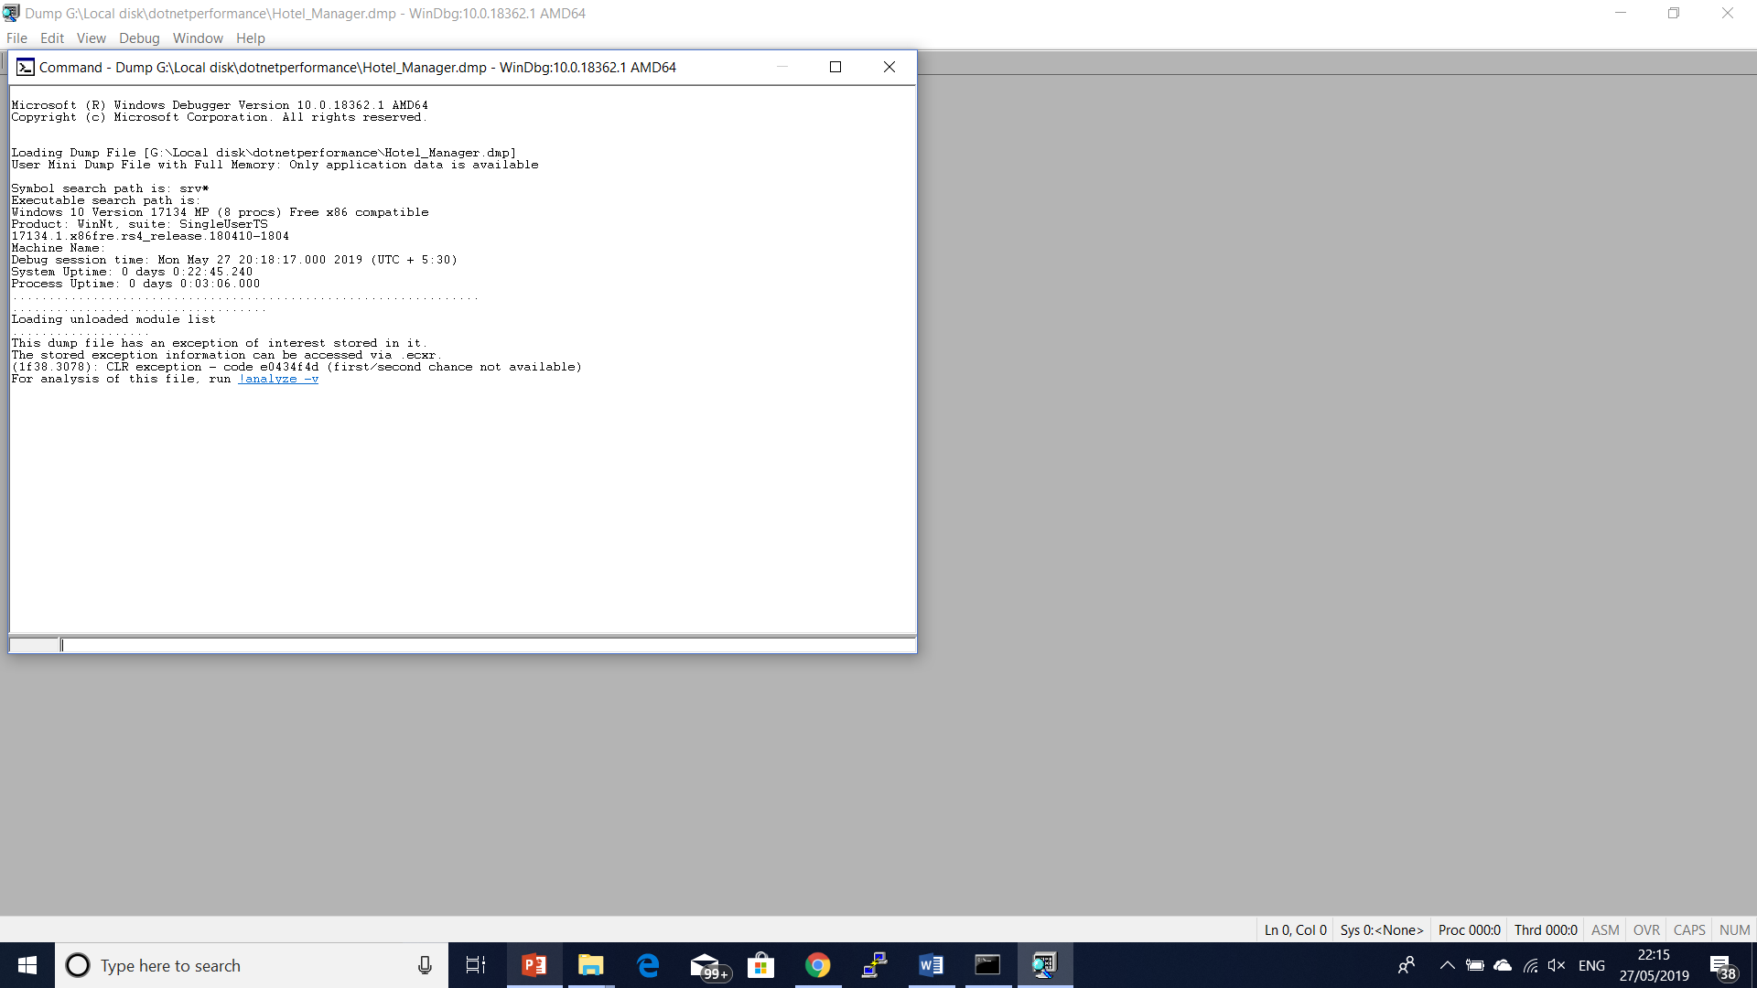
windbg

Slide 209
How to Examine Heap
Heap Statistics
Refer gencount example
Heap Searching
How to suspect the heap corruption?
The application crashes randomly with no regards to the applied exception catching and even goes through blankets like catch(Exception) which are supposed to catch all exceptions.
Examining the CLR stack in the application crash dumps shows the garbage collector on the top of the stack:

Slide 210
How to Examine Heap
The CLR stack always shows different points.
Whether the crash occurred or the code which is shown is clearly irrelevant, like StringBuilder's method which is shown to cause the exception.

Slide 211
How to Examine Heap
Debugging Heap Fragmentation.
heap fragmentation, in which free and busy blocks are arranged and interleaved on the managed heap in such a way that they can cause problems in applications that surface as OutOfMemory exceptions;
in reality, enough memory is free, just not in a contiguous fashion.
The CLR heap manager utilizes a technique known as compacting and coalescing to reduce the risk of heap fragmentation.

Slide 212
How to Examine Heap
The source code and binary for Listing 5-8 can be found in the following folders:
Source code: C:\Fragment
Binary: C:\Fragment.exe
The application enables the user to specify an allocation size and the maximum amount of memory that the application should consume. For example, if we want the allocation size to be 50,000 bytes and the overall memory consumption limit to be 100MB, we would run the application as following:
C:\Fragment 50000 100

Slide 213
Corrupt Heap Analysis
!heap -s –v

Slide 214
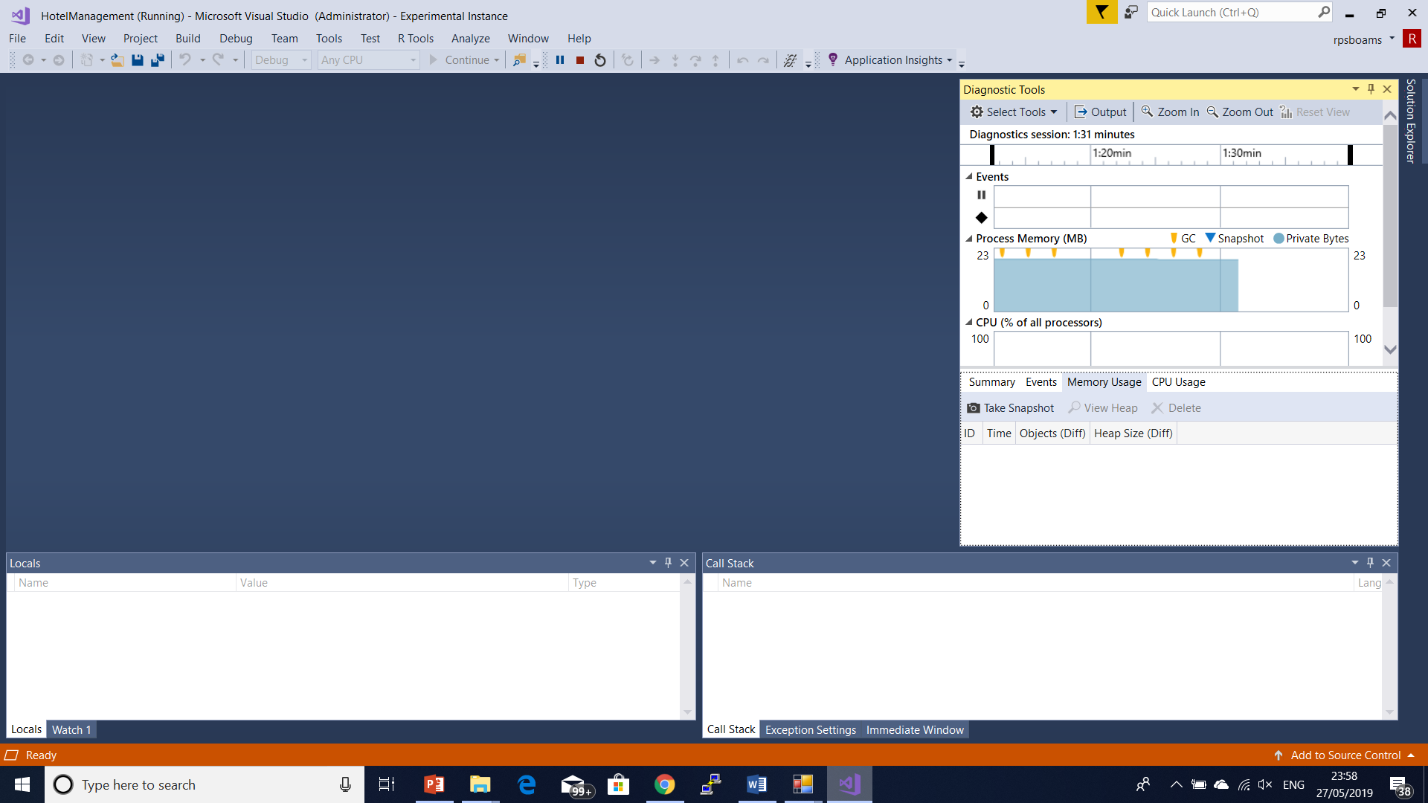
How to Examine Heap
Debug Windows show Diagnostic tools

Slide 215
VSPerfCmd
The VSPerfCmd.exe tool is used to start and stop performance data collection.
VSPerfCmd.exe /Start:Sample /Output:TestApp.exe.vsp
VSPerfCmd.exe /Launch:TestApp.exe /Sys:20

Slide 216
Questions

Slide 217
Module Summary
Understanding Memory Management
Memory Leaks
Using Performance Counters
Performance Measure and Leak Detection Tools

